Slide 1
TUBERCULOSIS (TB) BURDEN ANALYSIS BY AGE AND GENDER
A COMPREHENSIVE DATA ANALYTIC APPROACH USING THE SEER 1992-2020 DATASET
Group Members
Venkata Prathap Reddy Rachamalla
Raga Jyothsna Ravipalli
Deeksha Charagondla
Laxmi Chaitanya Garige

Slide 2
INTRODUCTION

Slide 3
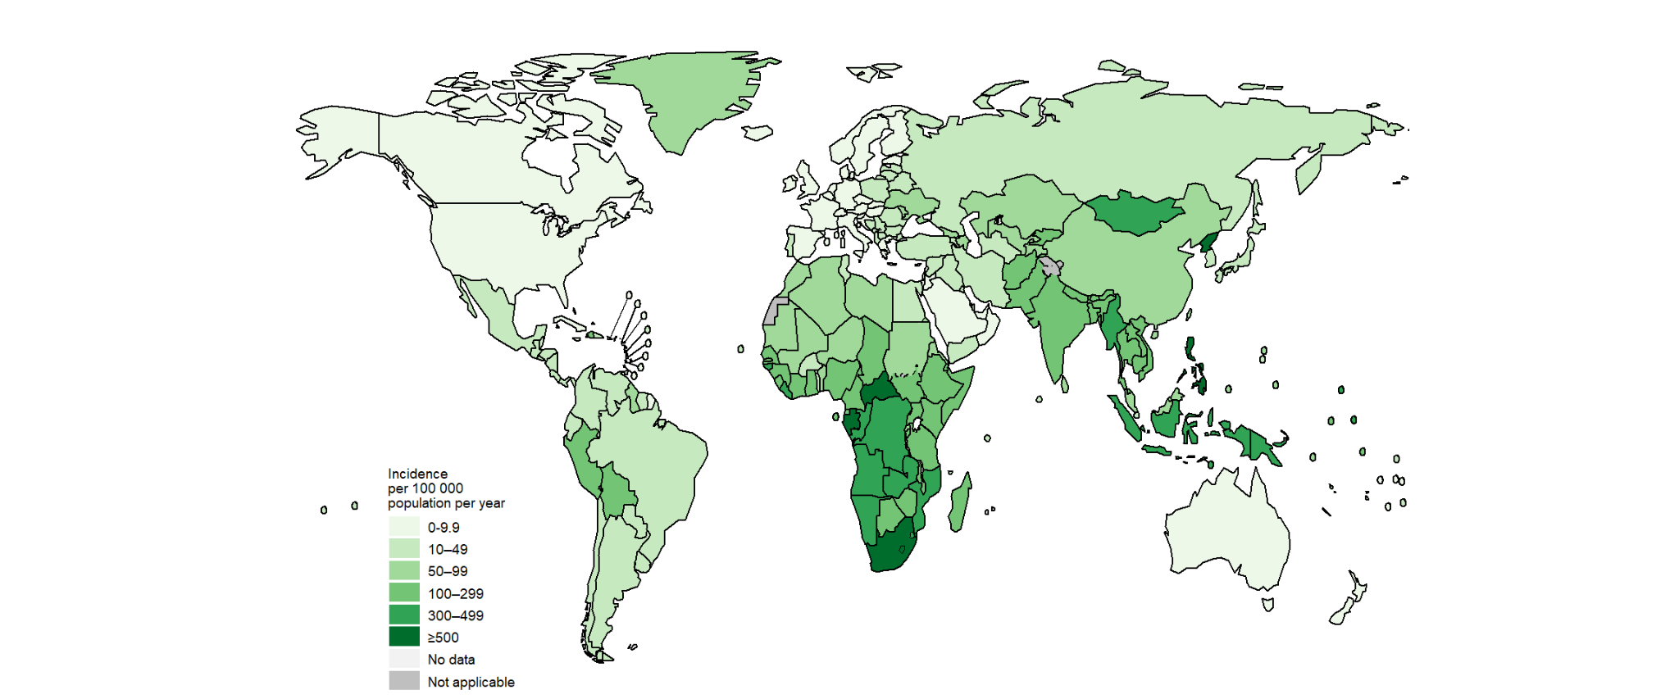
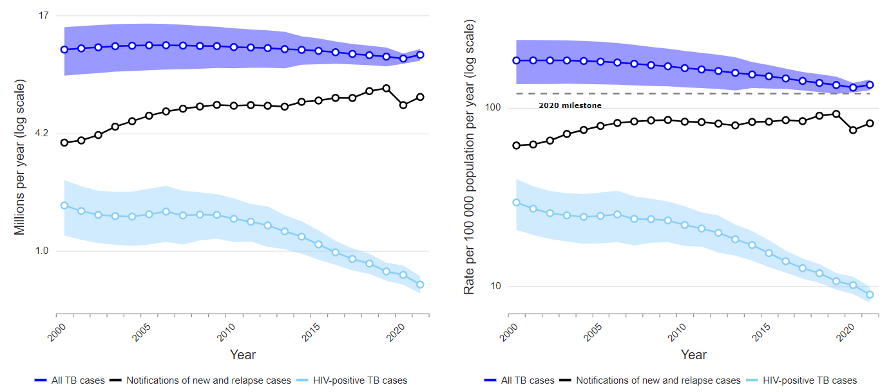
TUBERCULOSIS - THE GLOBAL CHALLENGE
Tuberculosis, an infectious disease caused by Mycobacterium tuberculosis, primarily affects the lungs (pulmonary TB) but can impact other areas (extra pulmonary TB).
One of the top 10 causes of death worldwide, TB is a leading killer of people who are HIV positive.
In 2020, an estimated 10 million people contracted TB globally, with 1.5 million TB-related deaths.
Addressing TB is a cornerstone in the fight for a healthier world, as outlined in the Sustainable Development Goals.
Global trends in the estimated number of incident TB cases (left) and the incidence rate (right), 2000–2021
Estimated TB incidence rates, 2021

Slide 4
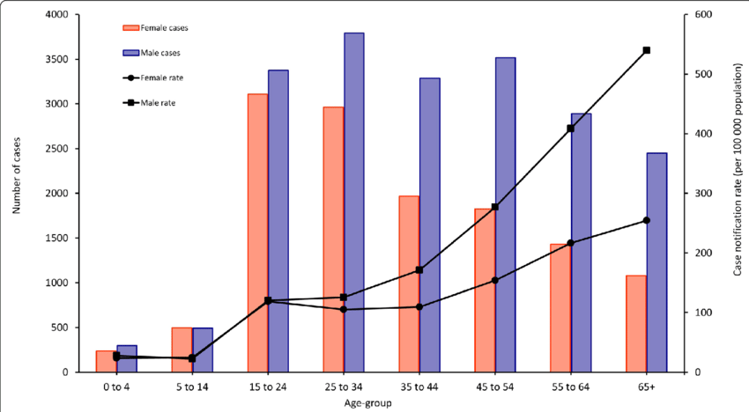
Why Analyze TB by Age and Sex?
Analyzing TB incidence by age and sex helps identify vulnerable populations and tailor public health interventions.
Sex-disaggregated data is crucial as TB prevalence and mortality are often higher among men, but women can experience barriers to access care.
Age-specific data guide vaccine strategies and screening programs, especially in high-burden settings.
Understanding the distribution of TB across different demographics is key to achieving the end TB strategy goals by 2035.
Number of notified tuberculosis cases and case notification rate by Gender and Age

Slide 5
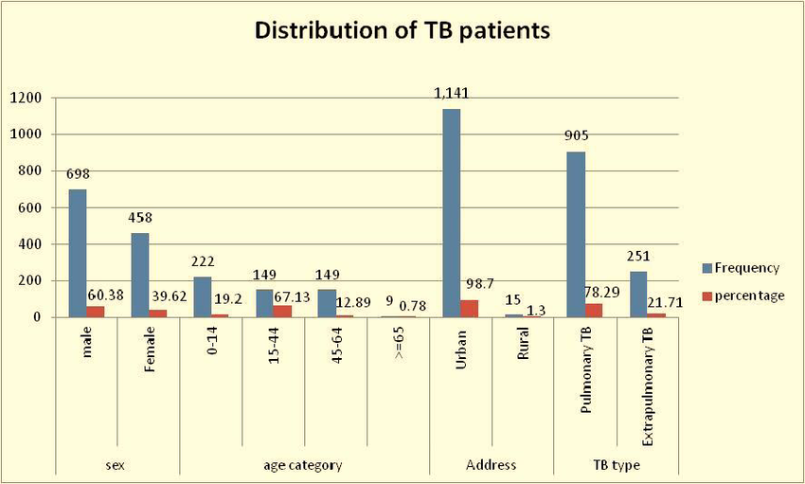
Tuberculosis: A Statistical Overview
In 2021, TB incidence rates ranged significantly, with countries like Afghanistan reporting 16000 cases in the 0-14 age group.
The gender distribution of TB shows disparities: in Afghanistan, 7600 reported cases were female, and 8200 male in the same age group.
The global treatment success rate for TB was approximately 85%, yet drug-resistant TB remains a public health crisis.
In high TB burden countries, the age group of 15-24 shows a high incidence, underlining the need for targeted interventions in young adults.
Distribution of TB patients by sex and age category

Slide 6
BACKGROUND

Slide 7
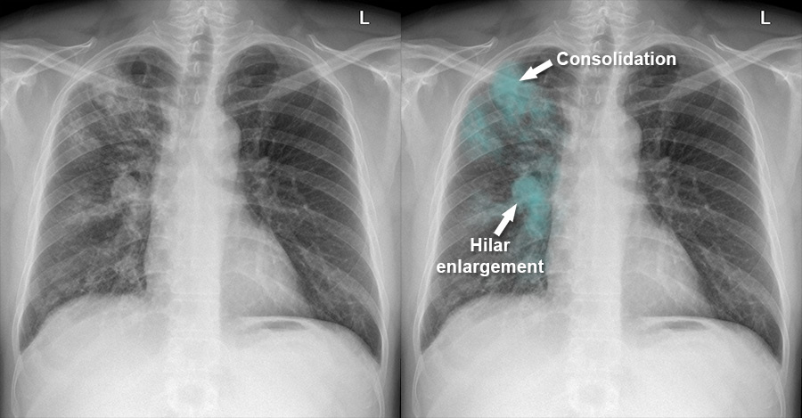
Tuberculosis: The Silent Epidemic
Tuberculosis (TB) is a bacterial infection caused by Mycobacterium tuberculosis.
It primarily affects the lungs (pulmonary TB) but can also affect other parts of the body (extra pulmonary TB).
TB is spread through the air when people with lung TB cough, sneeze, or spit.
Symptoms include a persistent cough, fever, night sweats, and weight loss.
If left untreated, TB can be fatal; however, it is largely preventable and treatable with a standard 6-month drug course.
Chest X-ray - Pulmonary disease - Tuberculosis

Slide 8
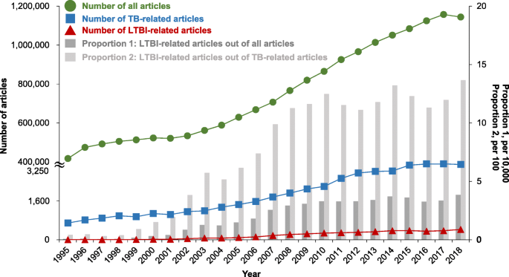
Global Incidence of Tuberculosis
According to the World Health Organization (WHO), TB is one of the top 10 causes of death worldwide.
In 2020, there were an estimated 10 million new TB cases worldwide.
The highest burden of TB is in the WHO regions of Africa, South-East Asia, and the Western Pacific.
Multi-drug-resistant TB (MDR-TB) is a growing concern, with an estimated 465,000 cases in 2019.
TB Trends Over Time

Slide 9
TB: A Public Health Perspective
TB is a leading cause of death among infectious diseases, particularly among young adults and those with HIV/AIDS.
The disease is a marker of poverty and inequality, disproportionately affecting marginalized communities.
The End TB Strategy by WHO aims to reduce TB deaths by 95% and cut new cases by 90% between 2015 and 2035.
Data analytics in TB is vital for tracking progress, understanding disease dynamics, and planning interventions.

Slide 10
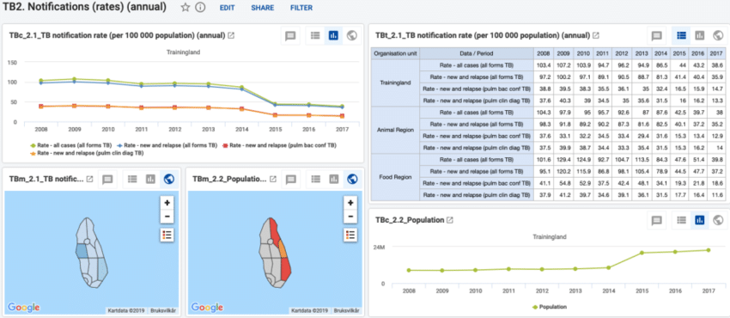
Leveraging Data in TB Control Efforts
Accurate data is essential for understanding the epidemiology of TB and for the effective delivery of TB services.
Data analysis helps in identifying high-risk populations, tracking treatment outcomes, and measuring program impact.
Big data and predictive analytics are becoming increasingly important in anticipating outbreaks and informing public health policies.
The use of data from diverse sources, including clinical, laboratory, and demographic data, enhances the precision of TB control strategies.

Slide 11
DATASET VARIABLES

Slide 12
S.No | Field (SAS Abbreviation) | Variable description | Variable Type
1 | Country | Country name | Categorical
2 | Iso 2 | International Organization for Standardization 2-letter country code | Categorical
3 | Iso 3 | International Organization for Standardization 3-letter country code | Categorical
4 | Year | Year | Continuous
5 | Measure | Measurement in inches | Categorical
6 | Unit | Units in number | Categorical
7 | Age_group | Age group | Categorical
8 | sex | Gender | Binary
9 | Risk_factor | Risk factor/Negative event | Categorical
10 | best | best | Continuous
11 | lo | low | Continuous
12 | hi | high | Continuous
Variables used for Analysis
12 Variables are used.
Categorical (7)
Binary (1)
Continuous (4)

Slide 13
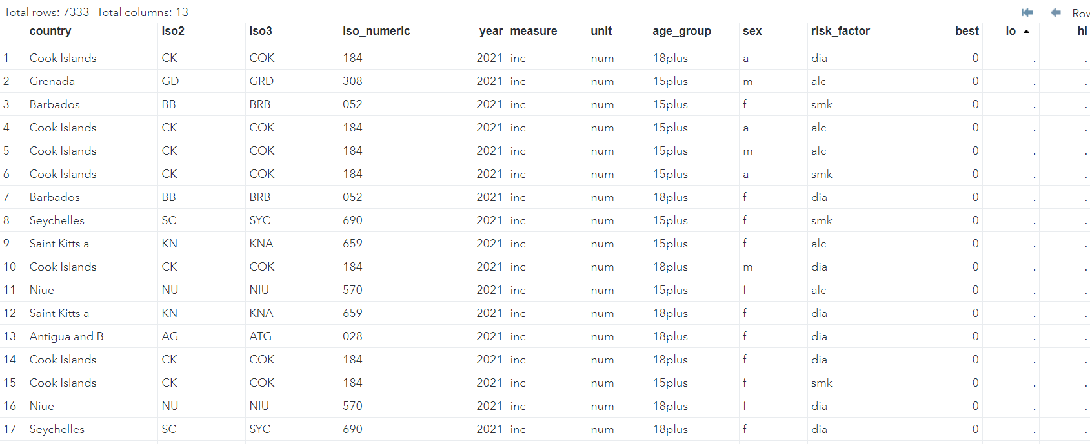
Dataset Variables ABBREVIATION
Country: The nation where TB cases are reported.
ISO Codes (2, 3, numeric): International codes that uniquely identify a country.
Year: The year in which TB cases were reported.
Measure & Unit: 'inc' for incidence and 'num' for numeric count.
Age Group: The age range of the population affected.
Sex: Gender of the affected individuals (a= all, f= female, m= male).
Risk Factor: Specific factors like alcohol use (alc) or smoking (smk).
Best, Lo, Hi: Estimate of TB cases (best) and the lower (lo) and higher (hi) bounds of the estimate.

Slide 14
"IMPORTING AND INITIAL CLEANING IN SAS
Data is imported using proc import with the CSV file path and output dataset name specified.
get-names=yes option is used to ensure column names are read from the first row of the CSV.
Initial check for missing data with proc freq, analyzing all variables.
Removal of rows with any missing values using cmiss function and a conditional statement in a data step.
MISSING DATA STRATEGY
IDENTIFIED MISSING DATA POINTS WITH PROC FREQ BY CHECKING FREQUENCY TABLES FOR ALL VARIABLES.
DECISION TO REMOVE INCOMPLETE ROWS TO ENSURE THE INTEGRITY OF THE ANALYSIS.
THE REMOVAL OF ROWS WITH ANY MISSING VALUES IS PERFORMED TO PREPARE FOR A CLEAN ANALYSIS DATASET.

Slide 15
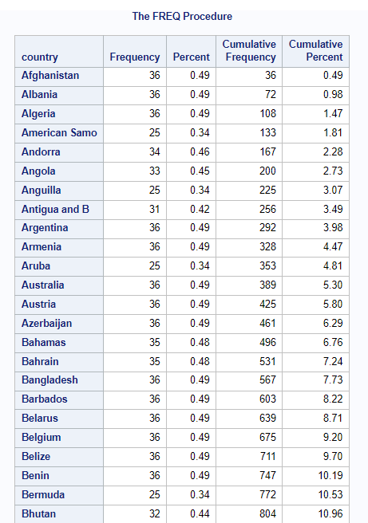
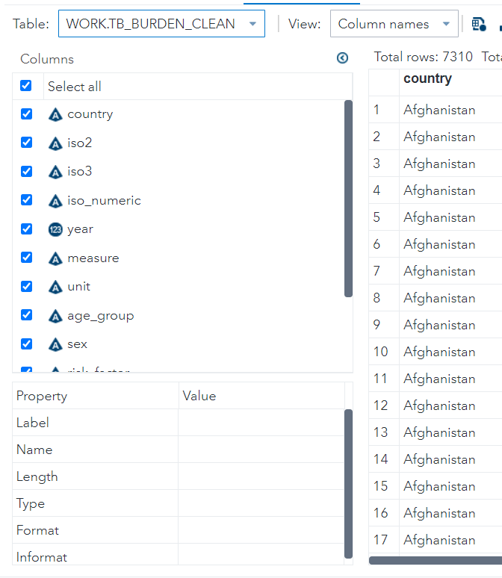

Slide 16
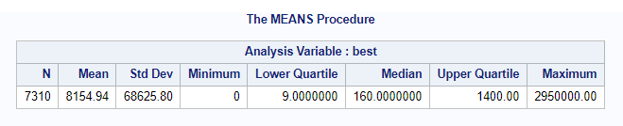
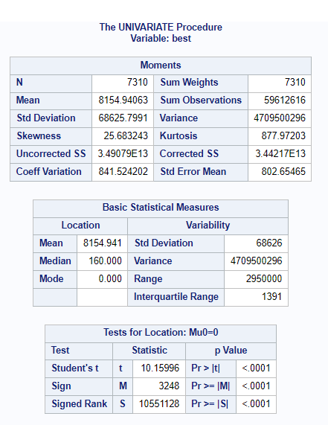
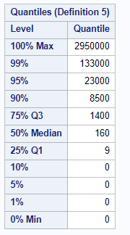
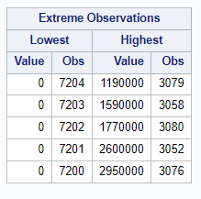
Descriptive Statistics
Analysis focused on the 'best' variable, which represents the best estimate of TB cases.
Used proc means to calculate the number of observations, mean, standard deviation, and other summary statistics for 'best'.
Visualized the distribution of 'best' with a histogram and overlaid normal curve using proc univariate.

Slide 17
SUMMARY OF DESCRIPTIVE STATISTICS FOR TB CASES
ANALYSIS OF EXTREME VALUES IN TB CASE ESTIMATES
The dataset contains a total of 7310 observations, indicating a robust sample size for analysis.
The average (mean) estimated number of TB cases (best) is 8154.94, with a significant standard deviation of 68625.79, suggesting a wide variation in the number of cases across observations.
The data exhibits a high degree of skewness (25.63) and kurtosis (841.52), implying a non-normal distribution with a heavy tail and potential outliers.
The median of 160 cases is markedly lower than the mean, reinforcing the presence of extreme values influencing the average.
THE LOWEST TB CASE ESTIMATES ARE CONSISTENTLY 0, WHICH MAY INDICATE MISSING REPORTS OR ABSENCE OF CASES.
THE HIGHEST TB CASE ESTIMATES SHOW EXTREME VALUES UP TO 295000, WITH THESE OUTLIERS POTENTIALLY REPRESENTING LARGE POPULATION CENTERS OR AREAS WITH SEVERE TB OUTBREAKS.
OBSERVATIONS WITH THE HIGHEST VALUES ARE FEW, SUGGESTING THAT SUCH EXTREME TB BURDENS ARE NOT COMMON.
EXPLORING THE RANGE AND DISPERSION OF TB CASES
STATISTICAL SIGNIFICANCE OF TB CASE ESTIMATES
THE DATASET RANGES FROM 0 TO A MAXIMUM OF 295000 TB CASES, WITH A BROAD INTERQUARTILE RANGE FROM 9 TO 1400, INDICATING DIVERSE TB CASE COUNTS ACROSS DIFFERENT REGIONS OR GROUPS.
50% OF THE OBSERVED TB CASE COUNTS FALL BELOW 160, WHICH IS MUCH LOWER THAN THE MEAN, HIGHLIGHTING THE INFLUENCE OF HIGH-VALUE OUTLIERS.
THE 99TH PERCENTILE OF DATA IS AT 133000 CASES, SHOWING THAT THE VERY HIGH CASE COUNTS ARE LIMITED TO THE TOP 1% OF THE DATA.
STUDENT'S T-TEST RESULTS (T = 10.15996) AND EXTREMELY LOW P-VALUE (<.0001) INDICATE THAT THE MEAN NUMBER OF TB CASES IS SIGNIFICANTLY DIFFERENT FROM ZERO.
THE SIGN TEST AND THE SIGNED RANK TEST BOTH REINFORCE THIS RESULT WITH P-VALUES SIGNIFICANTLY LESS THAN 0.05, CONFIRMING THE PRESENCE OF A SIGNIFICANT TB BURDEN.

Slide 18
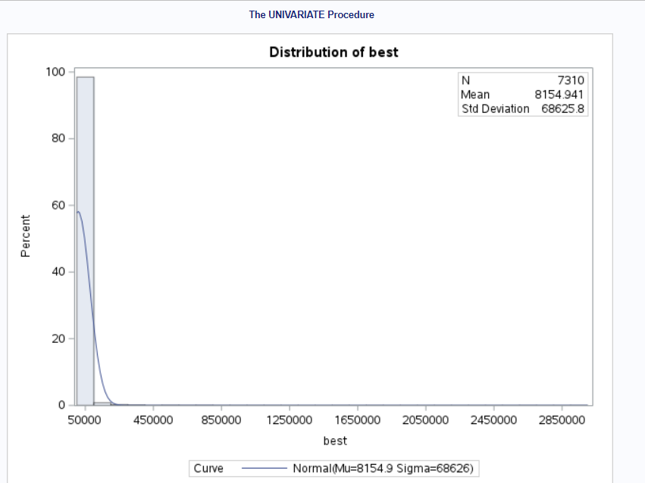

Slide 19
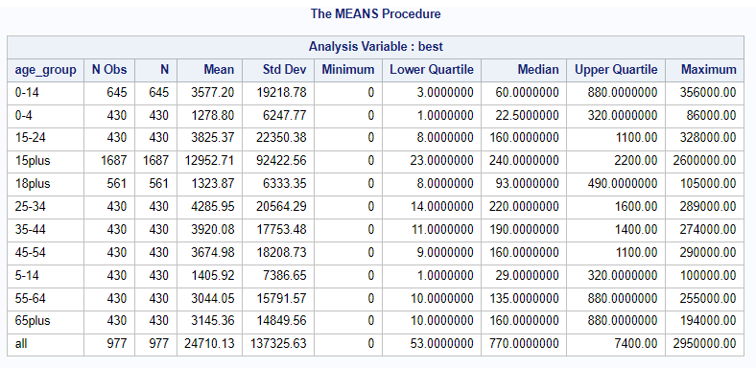
TB Cases Descriptive Statistics by Age Group
The '15plus' age group not only has the highest mean TB cases but also a large standard deviation, signifying high variability within this group.
The median TB cases are consistently lower than the mean within each age group, again reflecting the skewness in the data.
The maximum TB cases are observed in the 'all' category, which might be an aggregated count.

Slide 20
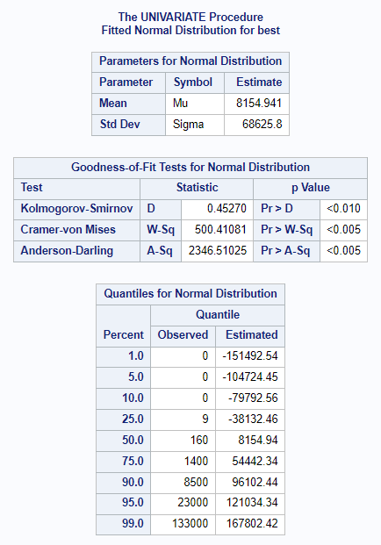
Distribution of Estimated TB Cases (Variable: best)
The histogram for the variable 'best' reveals a highly right-skewed distribution, indicating that the majority of observations have low TB case counts, with a few observations having very high counts.
The mean of TB cases is 8154.941, but the distribution's skewness suggests that this mean is not representative of a typical observation.
The standard deviation is large at 68625.8, reflecting the wide spread of TB case estimates across different observations.

Slide 21
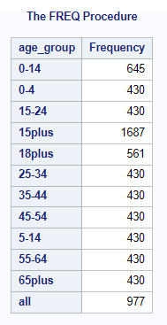
Frequency Distribution of TB Cases by Age Group
The age group '15plus' has the highest frequency of TB cases in the dataset with 1687 observations, indicating a broader age category.
Age groups '0-14', '5-14', and '55-64' have an equal frequency of 430, showing uniform data collection across these age ranges.
The 'all' category, likely representing the aggregation of all age groups, has 977 observations.

Slide 22
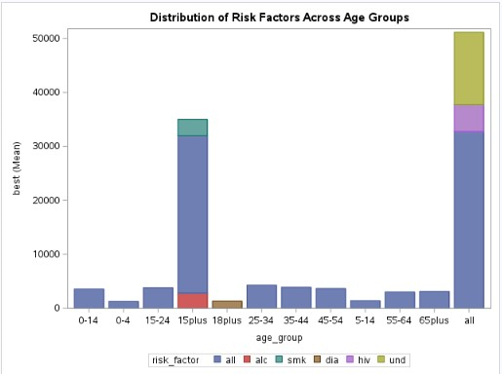
Distribution of Risk factors across age group
The bar chart titled "Distribution of Risk Factors Across Age Groups" displays the mean values of the 'best' variable for each age group, broken down by risk factors. The 'best' variable likely represents a measure related to TB burden, such as incidence rates or a similar metric. Each segment of a bar represents a different risk factor, such as alcohol (alc), smoking (smk), diabetes (dia), HIV, and an unidentified risk factor (und). The chart suggests that:The 15-24 age group has the highest mean TB burden across all risk factors combined ('all').There are significant differences in the mean TB burden between age groups.The 'und' risk factor has the highest mean TB burden in the 'all' age group category, which could mean it's prevalent or has a significant impact across all ages.

Slide 23
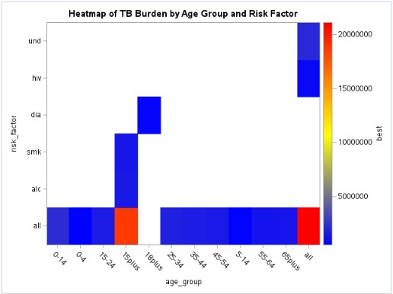
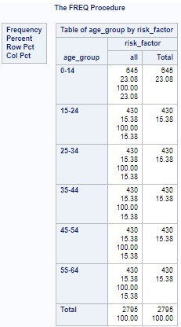

Slide 24
HEATMAP:
The heatmap provides a visual representation of the TB burden by age group and risk factor, with colors indicating the magnitude of the 'best' variable.
Darker colors represent higher values, meaning a greater TB burden. Observations include: The 'und' risk factor has the highest TB burden in the 'all' age category. There is a notable TB burden associated with the 'dia' risk factor in the '15-24' and '25-34' age groups.
The 'smk' risk factor appears to have a relatively lower TB burden across age groups compared to others. General Observations The 'und' risk factor, likely representing an unidentified or a composite risk factor, seems to contribute significantly to TB burden across all age groups.
Younger age groups, particularly '15-24' and '25-34', appear to be more affected by TB burden related to the 'dia' risk factor. There are discernible variations in TB burden by risk factor and age group, suggesting targeted interventions could be beneficial.

Slide 25
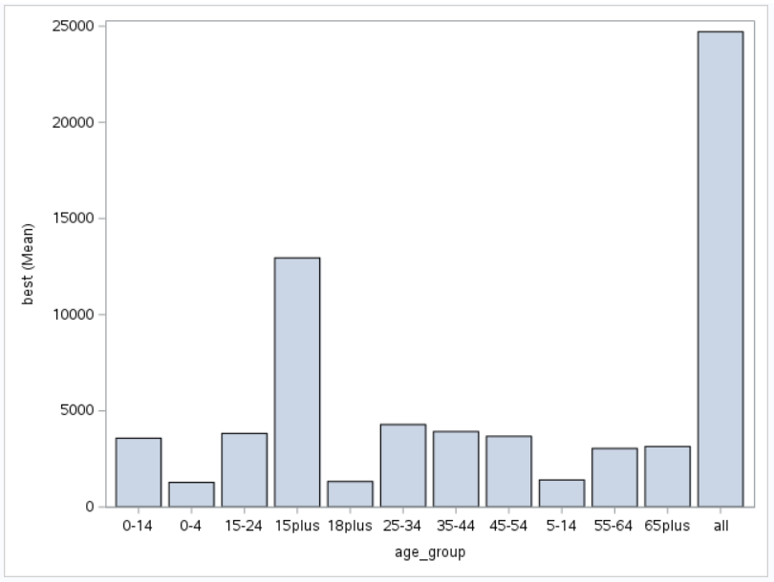
Average TB Cases by Age Group
The mean TB cases are highest in the 'all' category, followed by '15plus' age group, possibly reflecting cumulative cases.
The '15-24' age group shows a lower mean TB case count compared to older age groups, indicating a lower TB burden in this demographic.
The data visualization underscores the variability in TB case counts across different age groups.

Slide 26
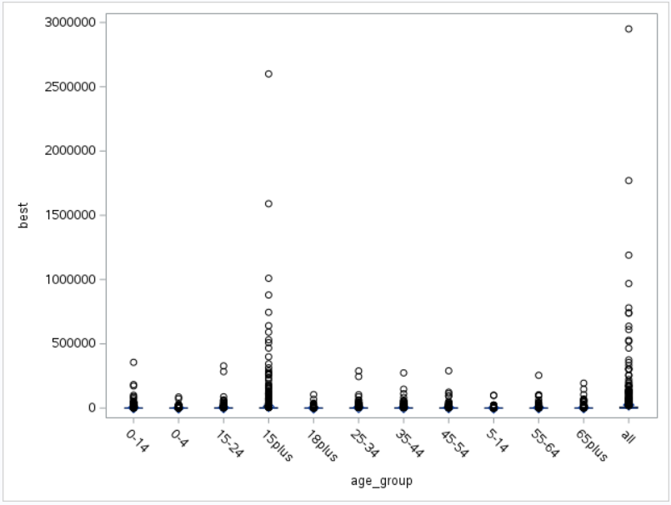
Distribution of TB Cases Across Age Groups
The boxplot displays a wide range of TB cases within age groups, with numerous outliers indicated by circles.
Age groups '15plus' and 'all' have the most pronounced spread of TB case counts, with many extreme values.
The visualization illustrates the non-uniform distribution of TB cases among different age demographics.

Slide 27
TESTING FOR NORMALITY IN TB CASE ESTIMATES
The Kolmogorov-Smirnov, Cramer-von Mises, and Anderson-Darling tests all indicate significant p-values (p < .010, p < .005, and p < .005, respectively), suggesting that the distribution of TB cases does not follow a normal distribution.
Such results are expected given the observed skewness in the histogram.
The observed quantiles compared to the estimated quantiles under a normal distribution show large discrepancies, especially in the tails, further confirming the non-normal nature of the data.
IMPLICATIONS OF NON-NORMALITY IN TB DATA
NON-NORMAL DISTRIBUTION OF TB CASES IMPLIES THAT MEDIAN AND MODE ARE MORE APPROPRIATE MEASURES OF CENTRAL TENDENCY FOR THIS DATA THAN THE MEAN.
THE PRESENCE OF OUTLIERS AND THE SKEWNESS NECESSITATE ROBUST STATISTICAL TECHNIQUES THAT DO NOT ASSUME NORMALITY FOR SUBSEQUENT ANALYSES.
THE RESULTS HIGHLIGHT THE IMPORTANCE OF EXPLORING DATA DISTRIBUTIONS BEFORE CONDUCTING PARAMETRIC TESTS, WHICH OFTEN ASSUME NORMALITY.

Slide 28
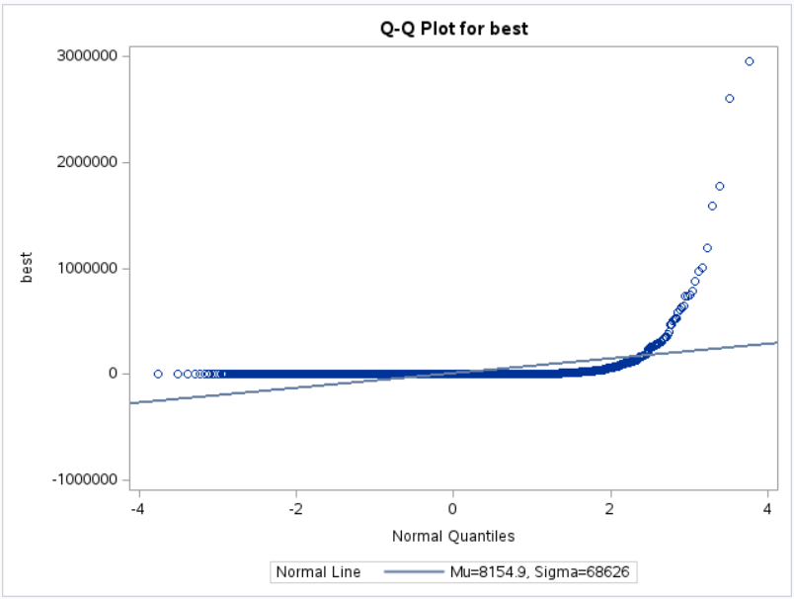
Normality Assessment of TB Case Estimates
The Q-Q plot for TB cases deviates significantly from the normal line, especially at the higher quantiles, indicating a non-normal distribution.
The histogram with the normal curve overlay shows a clear deviation from normality, with the curve not fitting the data well.
These plots confirm the earlier observations of skewness and the presence of outliers in the data.

Slide 29
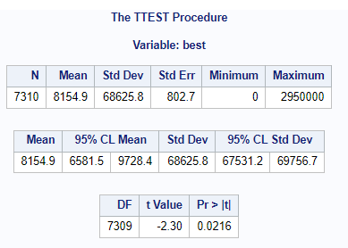
One-Sample T-Test Analysis for Variable “Best” TB Cases
The one-sample T-Test compares the mean estimate of TB cases against the null hypothesis that the mean is 10000.
The mean of TB cases is 8154.9, which is statistically significantly lower than 10000 (p-value = 0.0216).
The 95% confidence interval for the mean does not contain 10000, further suggesting that the population mean is less than 10000.

Slide 30
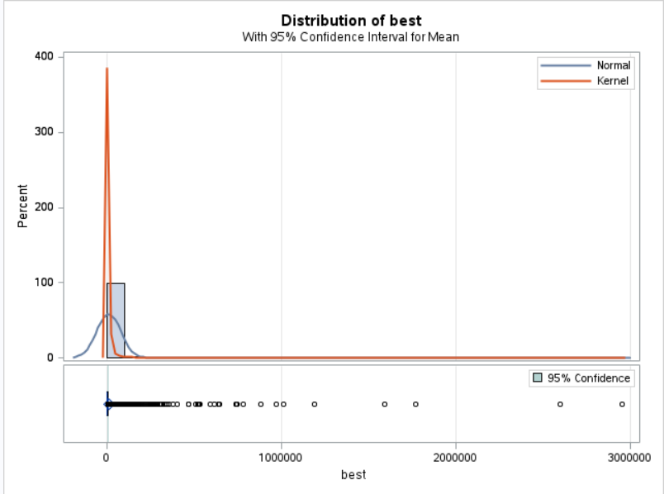
Confidence Interval on Distribution of Best TB Cases
The histogram with a 95% confidence interval for the mean shows a narrow interval relative to the distribution of 'best', indicating precision around the mean estimate.
The kernel density plot suggests a non-normal distribution with a peak far from the mean, highlighting the skewness toward lower values.

Slide 31
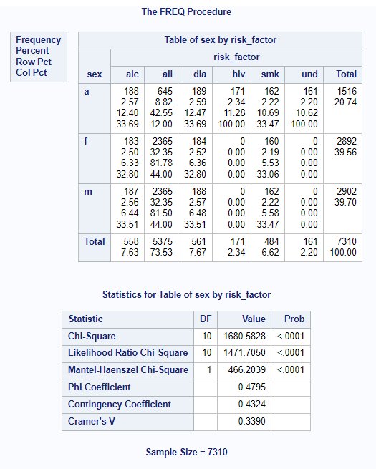
Chi-Square Test of Independence by Sex and Risk Factor
The Chi-Square test for the table of sex by risk factor is highly significant (p < .0001), indicating a strong association between sex and the distribution of risk factors.
The relative risk and odds ratio would give further insight into the strength and direction of the association between sex and specific risk factors.

Slide 32
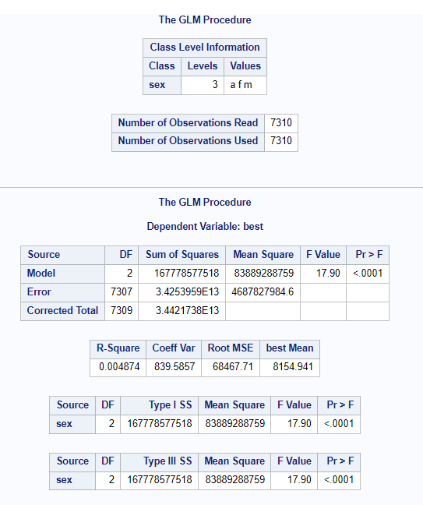
Analysis of Variance (ANOVA) for TB Cases by Sex
ANOVA results indicate that there are significant differences in the mean number of TB cases between the different sex groups (p < .0001).
Tukey's post hoc test shows significant pairwise differences between all sex categories, with 'a' (all) having a higher mean number of cases compared to 'f' (female) and 'm' (male).

Slide 33
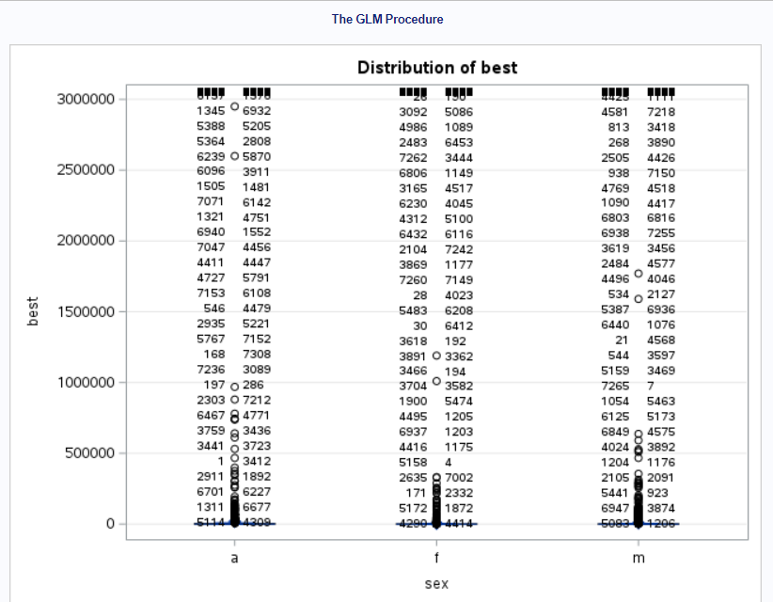
Tukey's Honestly Significant Difference Test
The test results indicate that the mean TB cases for 'all' are significantly different from 'male' and 'female' when controlling for Type I error across multiple comparisons.
The simultaneous 95% confidence limits help in understanding the range within which the true mean difference may lie.

Slide 34
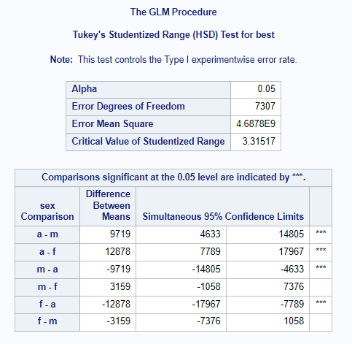
Notes:
Q-Q plot for 'best'.

Slide 35
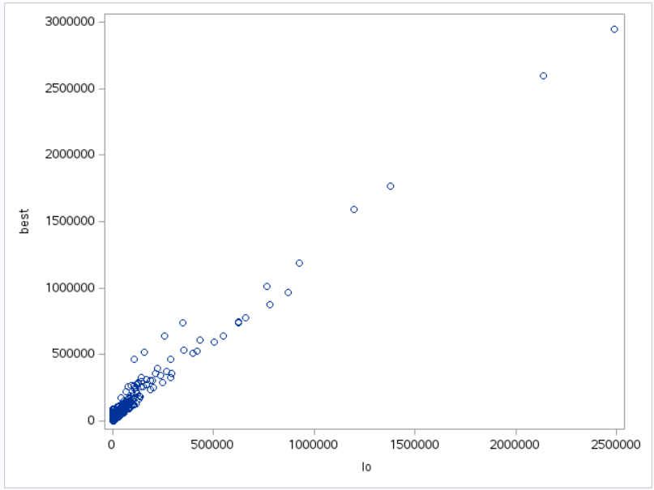
Relationship between Best Estimate and Lower Bound of TB Cases
A strong positive correlation (r = 0.98296) is observed between the best estimate and the lower bound of TB cases.
The scatter plot shows that as the lower bound increases, the best estimate also increases, indicating a linear relationship.
The extremely low p-value (< .0001) suggests this relationship is statistically significant.

Slide 36
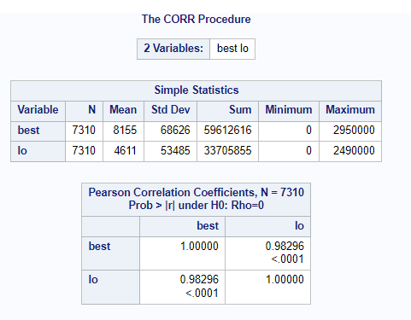
Notes:
The CORR Procedure output.

Slide 37
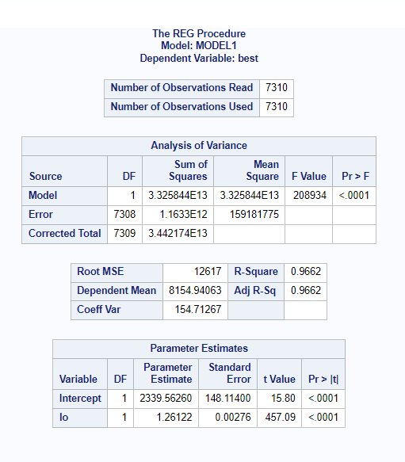
Linear Regression Analysis for 'best' Predicted by 'lo
The regression analysis yields a very high R-squared value of 0.9662, indicating that approximately 96.62% of the variability in 'best' is explained by 'lo'.
The regression line has a slope of approximately 1.26, meaning for every unit increase in 'lo', 'best' increases by 1.26 units.

Slide 38
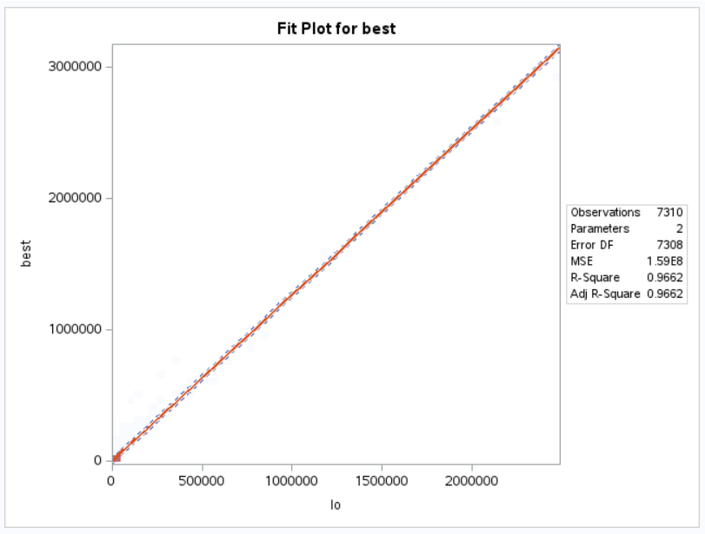
THE F-TEST IS SIGNIFICANT (P < .0001), INDICATING A STRONG MODEL FIT.

Slide 39
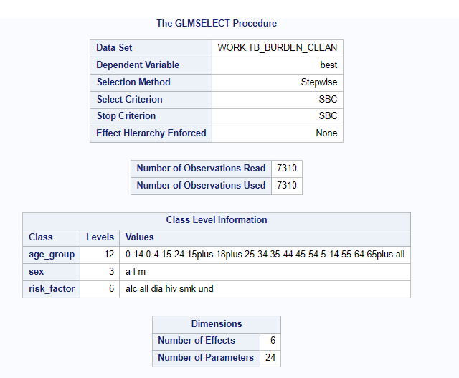
MULTIPLE REGRESSION MODEL SELECTION
Stepwise selection identified 'lo', 'hi', 'risk_factor', 'age_group', and 'sex' as significant predictors for the best estimate of TB cases.
The final model was chosen based on the Stepwise Bayesian Criterion (SBC), indicating a balance between model complexity and fit.
All effects are in the final model, suggesting each variable contributes unique information.

Slide 40
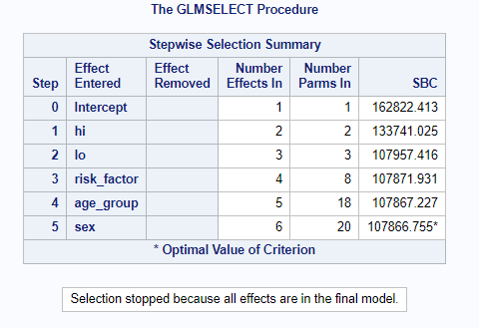

Slide 41
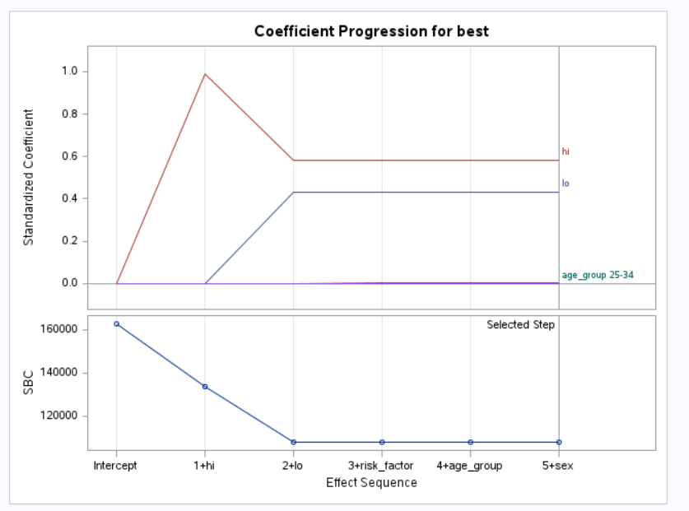
Notes:
Coefficient Progression for 'best'.

Slide 42
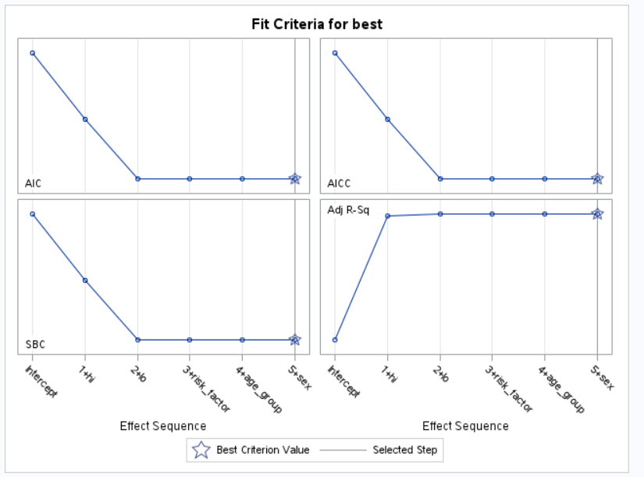
Notes:
Fit Criteria for 'best'.

Slide 43
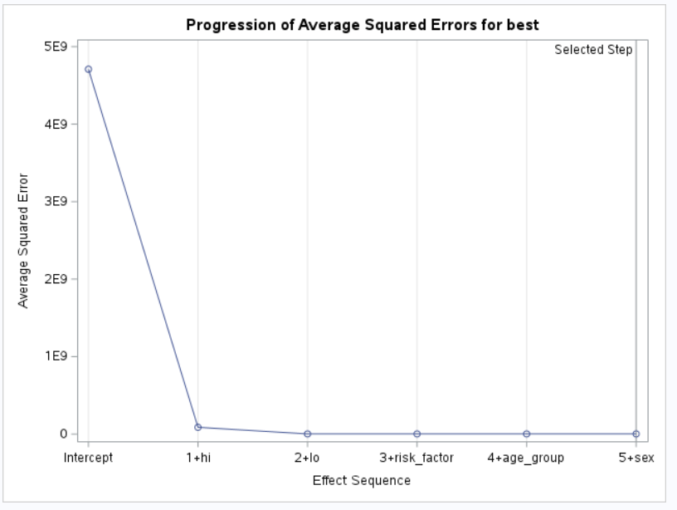
Notes:
Progression of Average Squared Errors for 'best'.

Slide 44
Discussion of Key Findings
The significant correlation between 'best' and 'lo' suggests that the lower bound is a strong predictor of TB case estimates.
The non-normal distribution of TB cases points to the need for robust statistical methods in future analyses.
Significant differences in TB case estimates across sex groups and risk factors highlight the importance of demographic and behavioral factors in TB prevalence.
The multiple regression analysis underscored the complexity of factors influencing TB case estimates, necessitating multifaceted public health strategies.

Slide 45
Conclusion
The analysis provided insights into the distribution and determinants of TB burden, which are essential for informed healthcare planning.
The strong predictive relationship between 'lo' and 'best' may be leveraged to improve TB case estimation methods.
The significant associations identified in the data underscore the importance of targeted interventions for specific demographic groups and risk factors.
WITH FREQUENCY DISTRIBUTION OF TB CASES, WE HAVE FOUND THAT 15+ AGE GROUP PEOPLE ARE MOSTLY AFFECTED WITH TB CASES WHICH RAISES THE IMPORTANCE OF TARGETED INTERVENTIONS FOR SPECIFIC DEMOGRAPHIC GROUPS AND RISK FACTORS.

Slide 46
RECOMMENDATIONS FOR FUTURE RESEARCH
Further investigation into the causative factors behind the disparities in TB cases among different sex groups and risk factors.
Longitudinal studies to assess the impact of public health interventions on TB case estimates over time.
Use of advanced predictive modeling techniques, such as machine learning, to improve the accuracy of TB case predictions.
STUDY LIMITATIONS
THE PRESENCE OF OUTLIERS AND SKEWED DATA MAY AFFECT THE GENERALIZABILITY OF THE REGRESSION MODELS.
THE CROSS-SECTIONAL NATURE OF THE STUDY LIMITS THE ABILITY TO INFER CAUSALITY BETWEEN VARIABLES AND TB CASES.
POTENTIAL UNMEASURED CONFOUNDING FACTORS COULD INFLUENCE THE RESULTS.
FINAL THOUGHTS
THIS ANALYSIS IS A STEP TOWARDS A DEEPER UNDERSTANDING OF TB BURDENS AND CAN CONTRIBUTE TO THE GLOBAL EFFORTS IN TB CONTROL AND PREVENTION.
THE INSIGHTS GAINED THROUGH THIS STUDY HIGHLIGHT THE NEED FOR DATA-DRIVEN APPROACHES IN PUBLIC HEALTH.
CONTINUED RESEARCH IS VITAL FOR REFINING THESE ANALYTICAL MODELS, WHICH CAN LEAD TO MORE EFFECTIVE TB CONTROL STRATEGIES.

Slide 47
References
Hamada, Y., Cirillo, D. M., Matteelli, A., Penn-Nicholson, A., Rangaka, M. X., & Ruhwald, M. (2021). Tests for tuberculosis infection: landscape analysis. The European respiratory journal, 58(5), 2100167. https://doi.org/10.1183/13993003.00167-2021
Atif, M., Anwar, Z., Fatima, R.K. et al. Analysis of tuberculosis treatment outcomes among pulmonary tuberculosis patients in Bahawalpur, Pakistan. BMC Res Notes 11, 370 (2018). https://doi.org/10.1186/s13104-018-3473-8
Ditah IC, Reacher M, Palmer C, Watson JM, Innes J, Kruijshaar ME, Luma HN, Abubakar I. Monitoring tuberculosis treatment outcome: analysis of national surveillance data from a clinical perspective. Thorax. 2008;63(5):440–446. doi: 10.1136/thx.2006.073916. - DOI - PubMed
Atif M, Sulaiman SA, Shafie AA, Ali I, Asif M, Babar ZU. Treatment outcome of new smear positive pulmonary tuberculosis patients in Penang, Malaysia. BMC Infect Dis. 2014;14(399):399. doi: 10.1186/1471-2334-14-399. - DOI - PMC - PubMed
Cremers AL, Gerrets R, Kapata N, Kabika A, Birnie E, Klipstein-Grobusch K, Grobusch MP. Tuberculosis patients’ pre-hospital delay and non-compliance with a longstanding DOT programme: a mixed methods study in urban Zambia. BMC Public Health. 2016;16(1):1130. doi: 10.1186/s12889-016-3771-9. - DOI - PMC - PubMed
Tachfouti N, Nejjari C, Benjelloun MC, Berraho M, Elfakir S, El Rhazi K, Slama K. Association between smoking status, other factors and tuberculosis treatment failure in Morocco. Int J Tuberc Lung Dis. 2011;15(6):838–843. doi: 10.5588/ijtld.10.0437. - DOI - PubMed
https://www.cdc.gov/tb/topic/testing/tbtesttypes.htm#:~:text=The%20TB%20skin%20test%20is%20performed%20by%20injecting%20a%20small,a%20reaction%20on%20the%20arm.
ttps://medlineplus.gov/tuberculosis.html

Slide 48
TEAM WORK
Raga Jyothsna Ravipalli – Descriptive statistics, statistical significance of tb case estimates, T test analysis, linear regression analysis and multiple regression analysis , discussion
Venkata Prathap Reddy Rachamalla – Handling and cleaning of missing data, test for normality, heatmap of TB burden, frequency distribution of tb cases, conclusion
Deeksha Charagondla - Chi square test, Anova, tukey’s honesty test, scattered plot between best and low variables, discussion, conclusion
Laxmi Chaitanya Garige – Introduction to tuberculosis, analysing tuberculosis by age and sex, statistical overview, leveraging data in tb control effects, discussion

Slide 49
Thank you!

